Slide 1
Hr attrition data analysis
welcome
A Brief introduction to the HR ATTRITION DATA ANALYSIS which helps to increase the Growth of Company Profit and Looks after the Wellness of Employees.

Slide 2
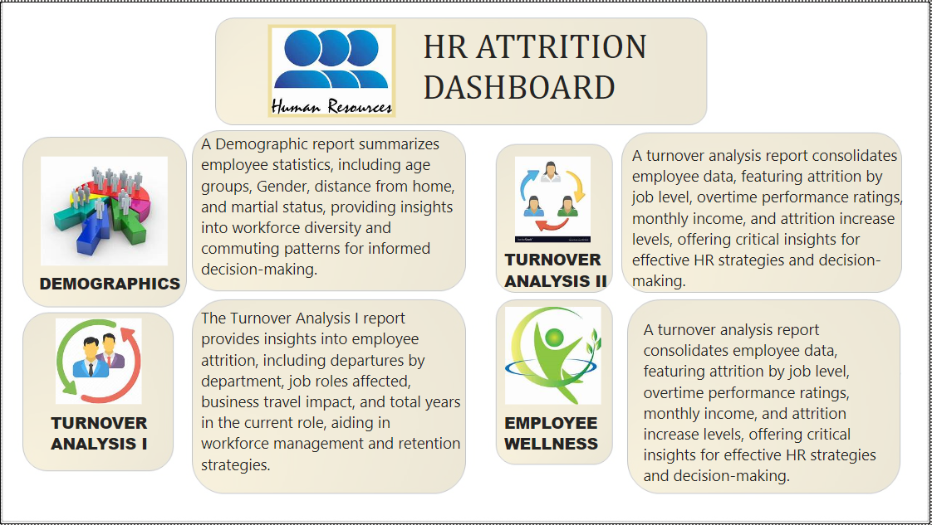

Slide 3
Data Visualization:
Tasks to perform
Data Cleaning:
Deleting redundant columns.
Renaming the columns.
Dropping duplicates.
Cleaning individual columns.
Remove the NaN values from the dataset
Check for some more Transformations
Plot a correlation map for all numeric variable Overtime
Marital Status , Gender
Job Role
Education Field , Department , Business Travel
Relation between Overtime and Age
Total Working Year
Education Level
Number of Companies Worked
Distance from Home

Slide 4
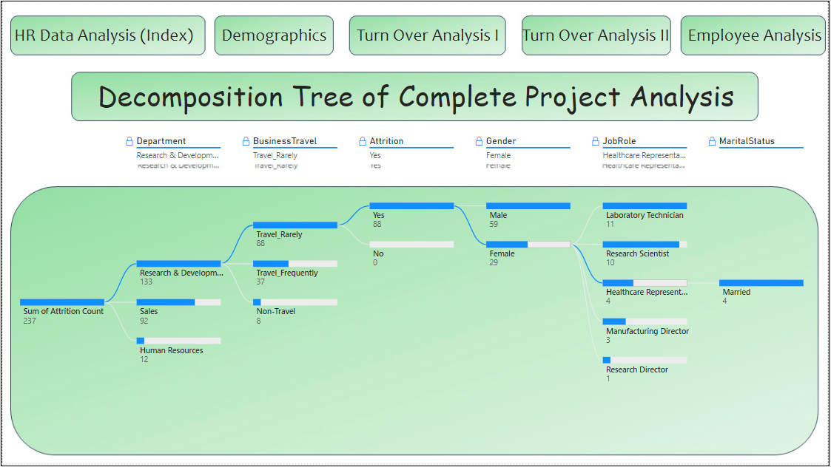

Slide 5
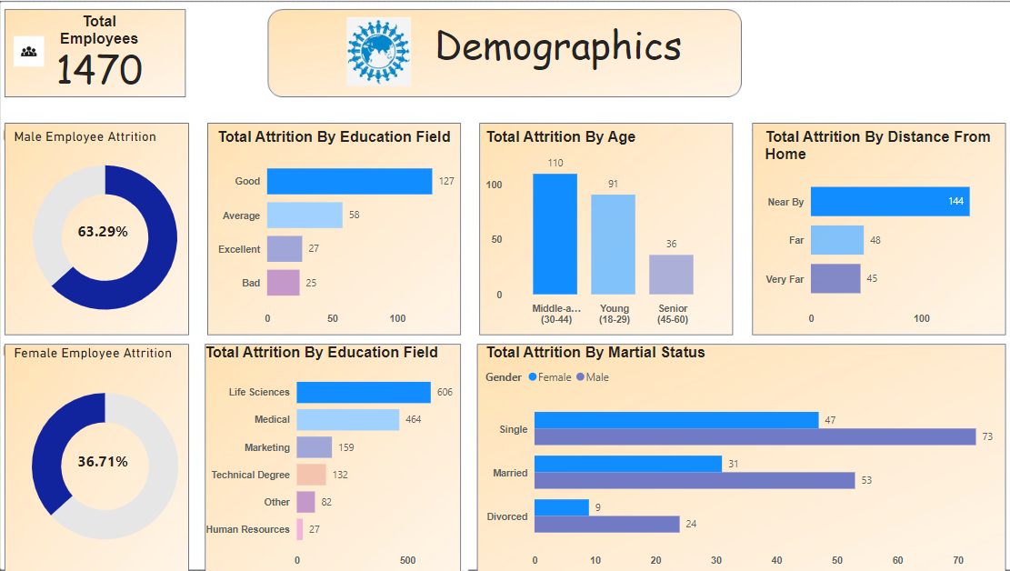

Slide 6
KEY INSIGHTS:
Analysis done on the employees are nearly 1470.
Male distribution in company is nearly 63.29%.
Female distribution in company is nearly 36.71%.
Maximum age for attribution is 78 years.
Life science and medical field has more attribution than any other field.
Around 127 members give average in work satisfaction.
Distance from home is also a key factor in this analysis which give them a mental stability and accuracy in mind.
Unmarried employee give more contribution to company compared to married Employee.

Slide 7
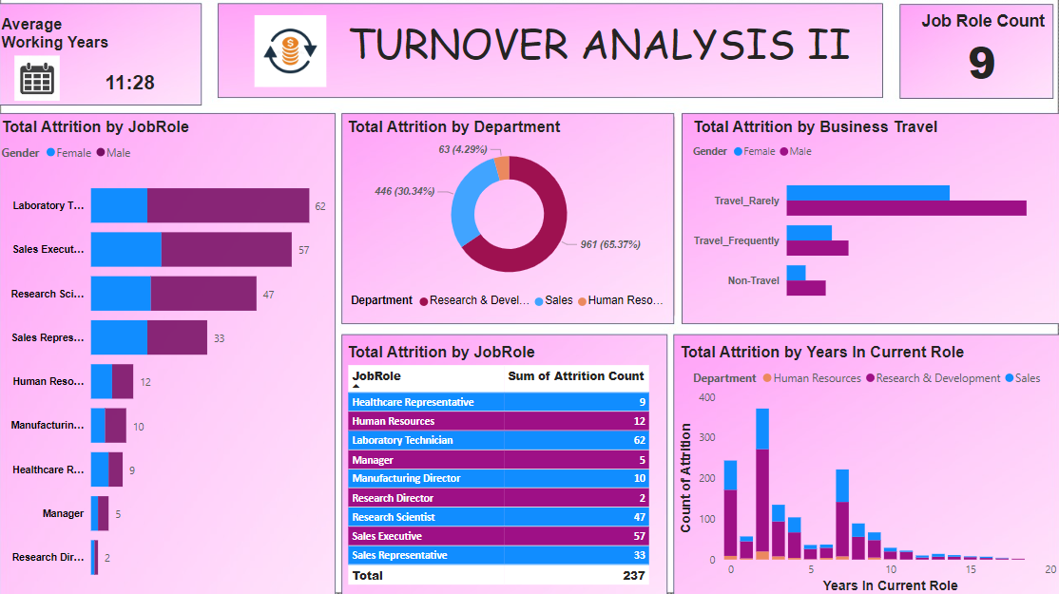

Slide 8
KEY INSIGHTS:
Turnover analysis a key in maintaining people mental health and dependencies.
Total Job roles in the company is 9.
Average working hours in the company is 11:28 hours.
Research & Development, Sales and Human Resources plays a key in the company development, Research & Development is most vital taking around 65.37% in attributions.
Male employee travel in rarely category are nearly 102 people and female employee travel for same nearly half of them around 54 people.
Laboratory Technician is acquired maximum no. of employee in company.

Slide 9
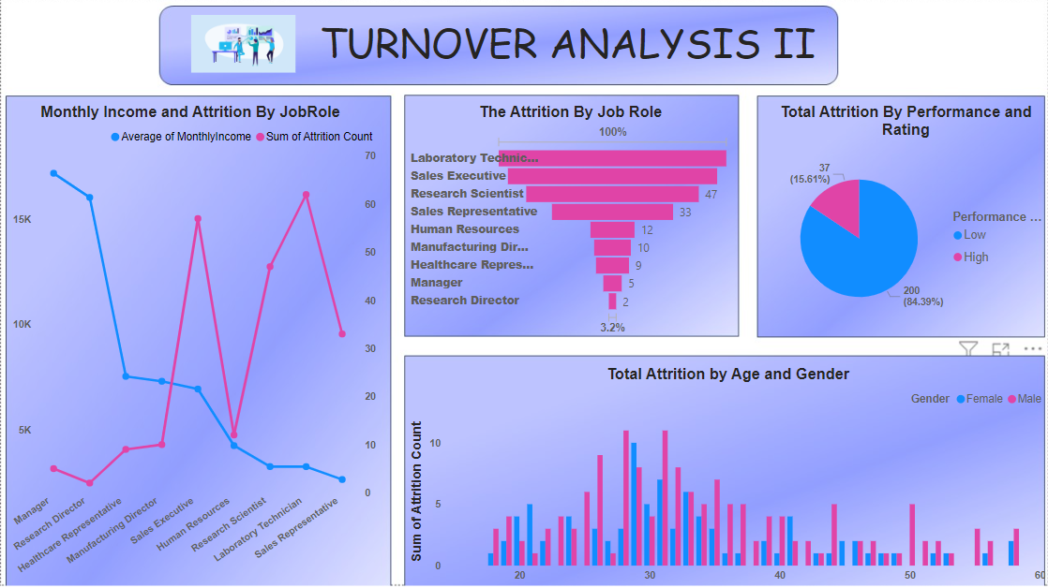

Slide 10
KEY INSIGHTS:
Turnover analysis a key in maintaining people wages, contribution and dependencies.
Male employees are high contributed to company compare of female employee.
Overall performance rating of company is Low, where Low stands of 84.39% and High stands for 15.61%.
Average Salary of a Manager in Company is 17.2K.
Minimum salary of any employee with different job role is 2.6K.
Male age at 31 and 28 has maximum attribution count, female has maximum count at 29.

Slide 11
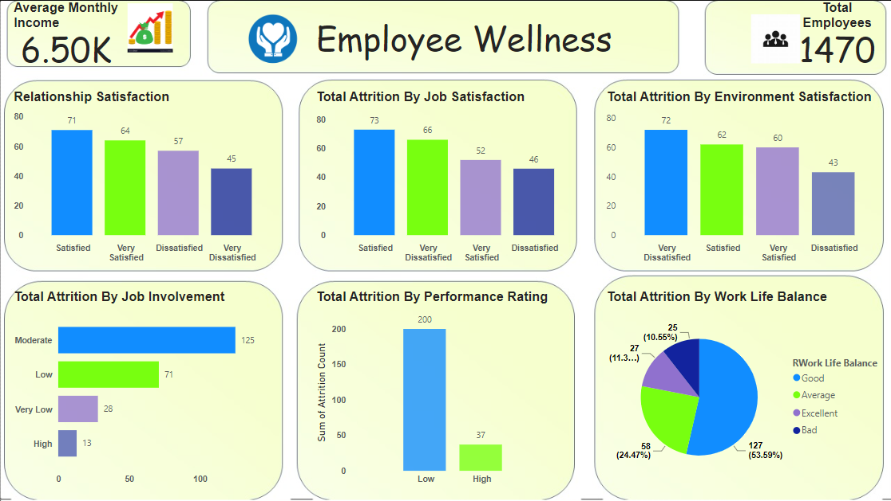

Slide 12
KEY INSIGHTS:
Employee Wellness plays a key role in Company development.
By Environment purpose employees are not satisfy for work due to people are given only 72 Votes.
As per voting employees are manage work life and personal life, Voting rate in good category is 127 with 59.57% of overall voter.
Performance rating is not good as per voting, voting rate is 200 stands for Lower category and 37 is Higher category.
Average monthly income of employees is 6.50k, where total employees are 1470.

Slide 13
Thank you
This Project successfully identified key factors contributing to employee attrition, providing actionable insights for improving retention strategies. Future work should focus on implementing targeted interventions and monitoring their effectiveness over time.

